Slide 1
Unit 6
Graphical Standard

Slide 2
Need for Machine Independent Graphical Languages
A machine independent graphical language allows a graphics program to run on different hardware and operating systems without modification.
Need
  Earlier graphics programs were:
  Hardware dependent
  Not portable
  Difficult to maintain

Slide 3
Advantages
Portability – same program runs on different systems
Device independence – no need to rewrite code for new devices
Standardization – uniform way of drawing graphics
Reduced cost – less redevelopment
Longevity – programs remain usable even when hardware changes
Example
A graphics program written using GKS can run on: Raster displays Vector displays Printers without changing the source code.

Slide 4
Graphical Standard
Graphical kernel System (GKS)
Programmer’s Hierarchical Interactive Graphics System (PHIGS)

Slide 5
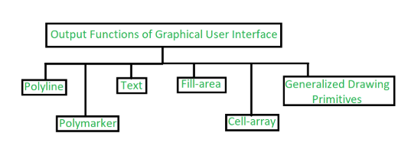
GKS
Graphical Kernel System is recognized as one of the first graphics software standards by the ISO (International Standards Organization) which is the most important organization that manages the top-level two-dimensional two-dimensional three-dimensional standards related to computer study. the GKS standard was also recognized by the ANSI or American National Standards Institute later.

Slide 6
PHIGS
PHIGS is the second standard developed in, computer graphics for the development of computer systems and software, it is known as an advancement to the previous standard because it supports more increased capabilities for the modeling of objects, better picture manipulation and other color specification guides.

Slide 7
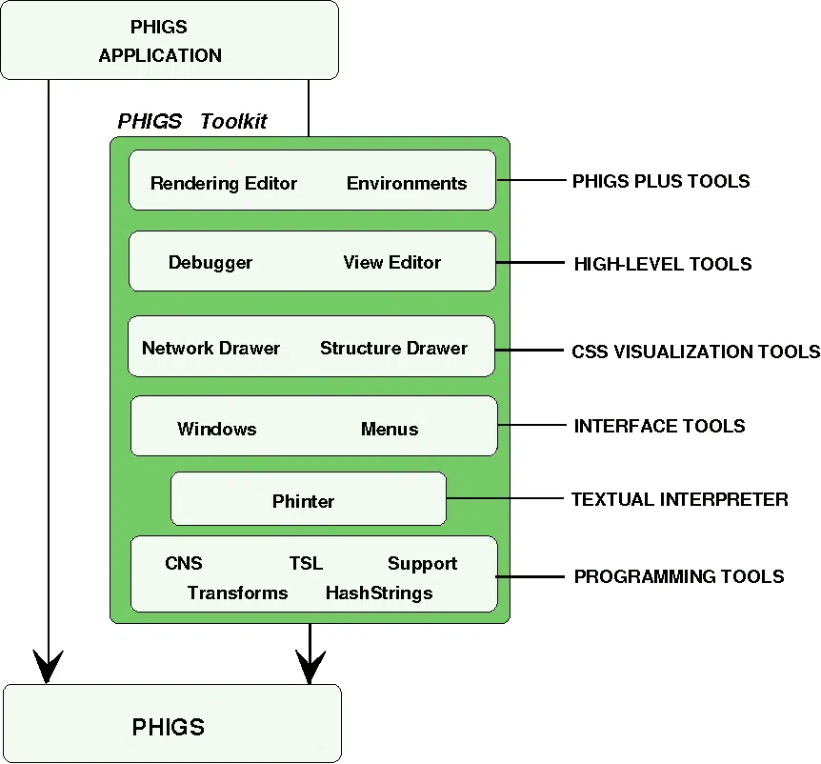

Slide 8
Language Binding
Language binding refers to the process of connecting a graphics standard to a specific programming language, so that the functions of the graphics standard can be accessed using that language.
Language binding refers to the process of connecting a graphics standard to a specific programming language, so that the functions of the graphics standard can be accessed using that language.
Examples
GKS–C → GKS functions used in C programs
GKS–FORTRAN → GKS functions used in FORTRAN
PHIGS–C → PHIGS used with C language

Slide 9
Graphical File Format
Raster File Format
Vector File Format

Slide 10
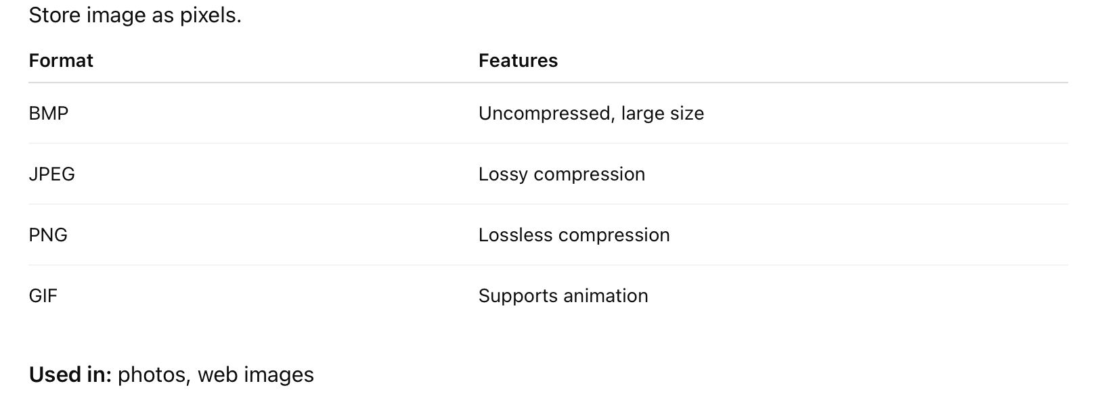
Raster (Bitmap) Formats

Slide 11
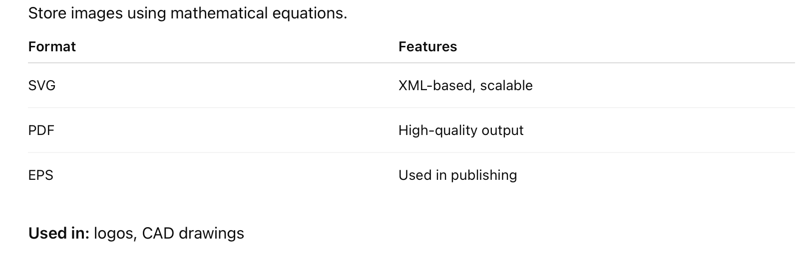
Vector Formats

Slide 12
OPENGL Callback Function
In OpenGL, especially when using GLUT (OpenGL Utility Toolkit), callback functions are user-defined functions that GLUT calls automatically in response to events such as display refresh, keyboard input, mouse actions, window resizing, etc.

Slide 13
Example
1.glutDisplayFunc(display);
2.glutReshapeFunc(reshape);
3.glutKeyboardFunc(keyboard);
4.glutSpecialFunc(specialKey);
5.glutMouseFunc(mouse);

Slide 14
glutDisplayFunc()
Called when the window needs to be redrawn
Used for all drawing operations
void display() {
glClear(GL_COLOR_BUFFER_BIT);
// drawing code
glFlush();
}

Slide 15
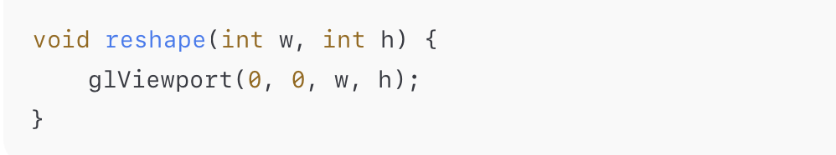
glutReshapeFunc()
Called when the window is resized
Used to adjust viewport and projection

Slide 16
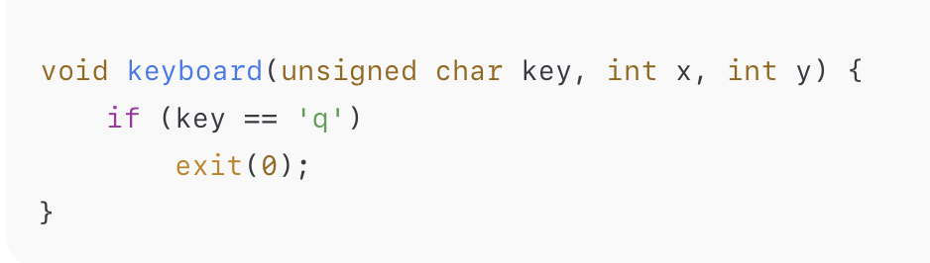
glutKeyboardFunc()
Called when a key is pressed
Used for keyboard interaction

Slide 17
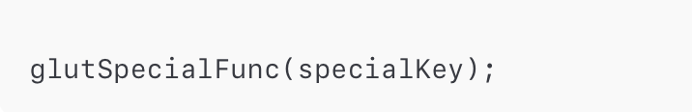
glutSpecialFunc()
Handles special keys like:
Arrow keys
Function keys (F1–F12)

Slide 18
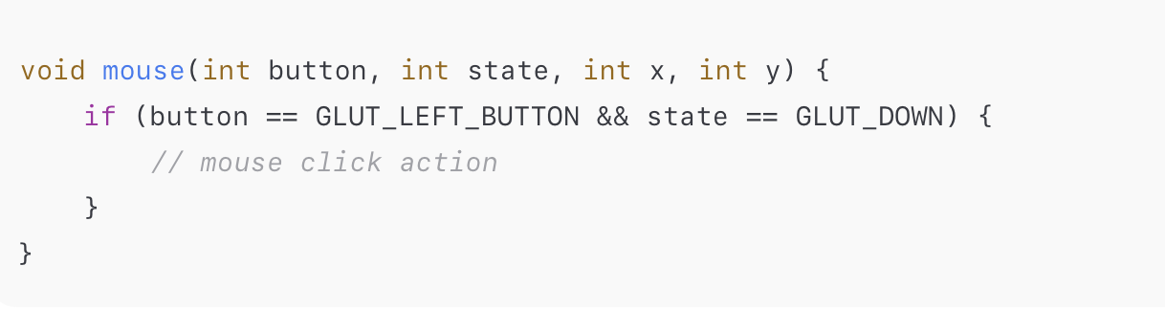
glutMouseFunc()
Called on mouse button press/release

